Slide 1


Introduction to AWS
Solution for compute, storage and networking
Pay-as-you-go model

Slide 2


Introduction to AWS

Slide 3




BASICS OF
AWS
MODULE: 2
Introduction to AWS
www.aisciences.io

Slide 4
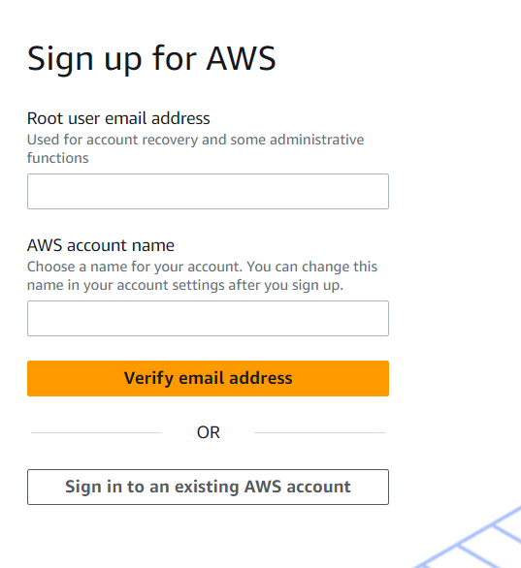
How to Create AWS Account
Credit/Debit card
Email Account

Slide 5
How to Create AWS Account
Potential Issues
Troubleshooting
Payment Processing via bank
Incorrect phone or Email
Read AWS FAQ
Contact AWS Support
Contact your financial institution

Slide 6


AWS Services
Streaming and Ingestion
Databases
and
Network
Analytics

Slide 7

Transformation and Analytics

Slide 8
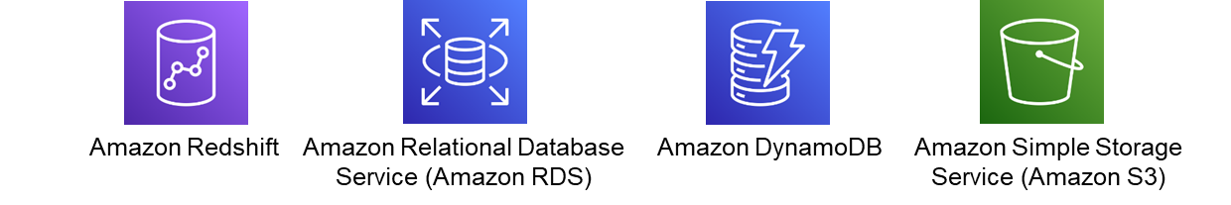
Data Warehouse and Database

Slide 9
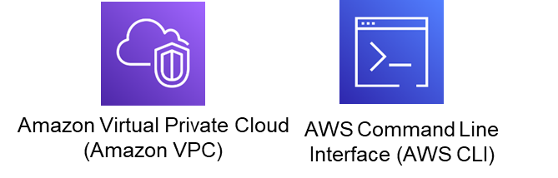
Networking

Slide 10

Streaming and Integration

Slide 11





IAM Policy
Human Resource
Salary of Employees
Developer

Slide 12
BASICS OF
AWS
MODULE: 3
COMPUTE AND STORAGE SERVICES
www.aisciences.io

Slide 13
Simple Storage Service
• Amazon S3 allows people to store objects (files) in “buckets” (directories)
• Buckets must have a globally unique name (across all regions all accounts)

Slide 14


Bucket Versioning
Name: Image.png
Version: 1
Name: Image.png
Version: 2

Slide 15
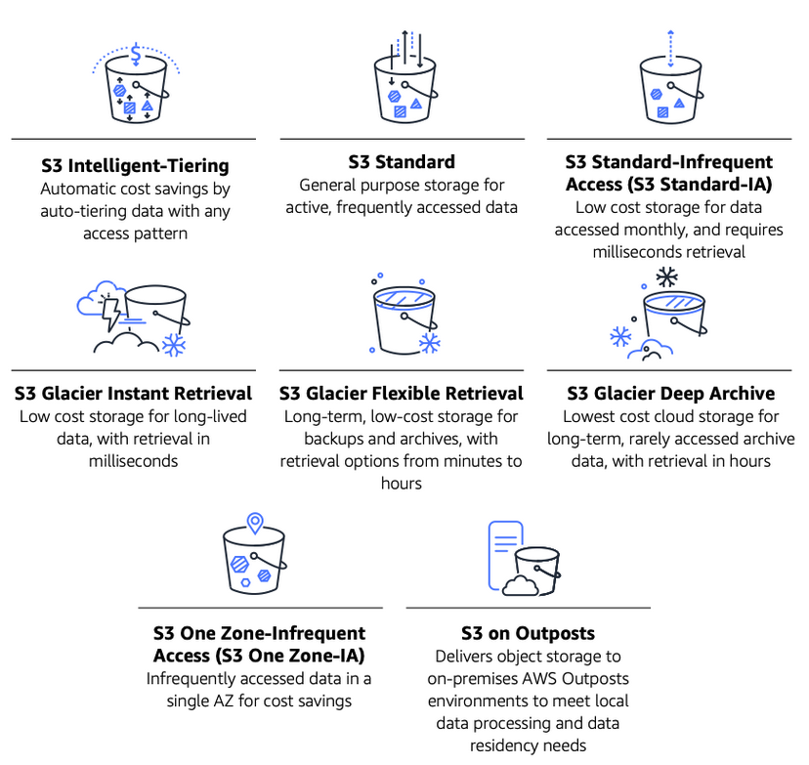
Storage Classes in S3

Slide 16
Storage Classes in S3

Slide 17
Storage Classes in S3

Slide 18


Event Trigger
uploads
trigger

Slide 19

AWS Lambda
• run code in response to Events
• serverless compute

Slide 20
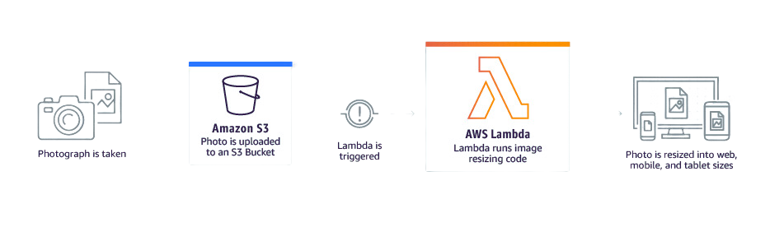
AWS Lambda : Usecase

Slide 21
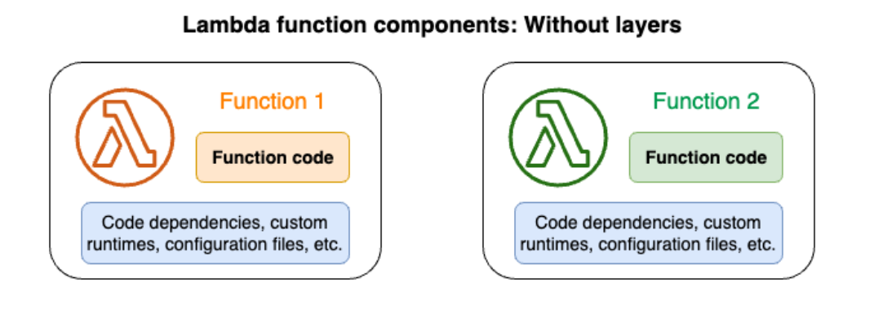
AWS Lambda : Layers

Slide 22
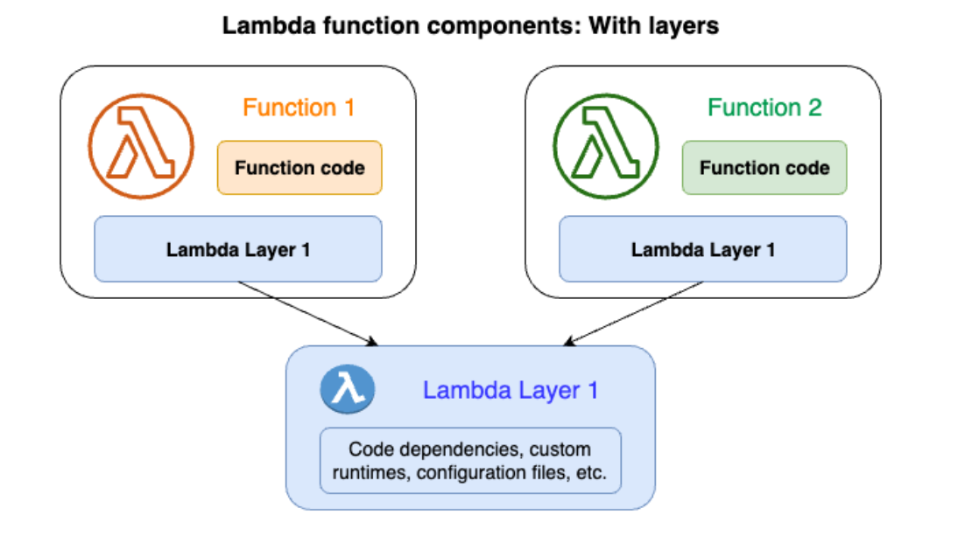
AWS Lambda : Layers

Slide 23
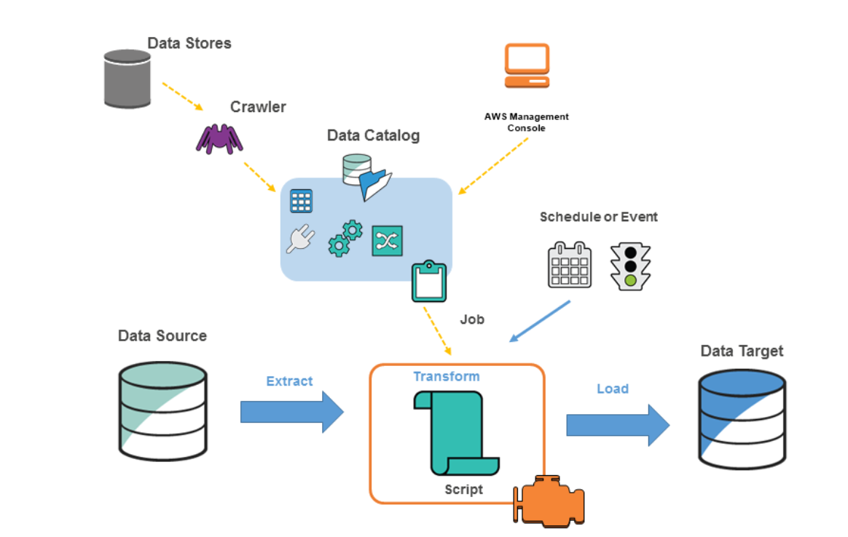
AWS Glue

Slide 24
BASICS OF
AWS
MODULE: 4
Infrastructure as Code and Automation
www.aisciences.io

Slide 25




Cloudformation
Template

Slide 26
BASICS OF
AWS
MODULE: 5
Network and Databases
www.aisciences.io

Slide 27



Virtual Private Cloud

Slide 28
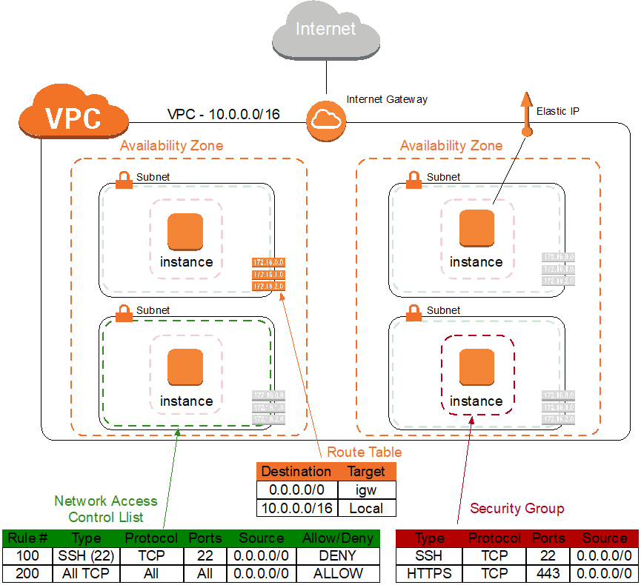
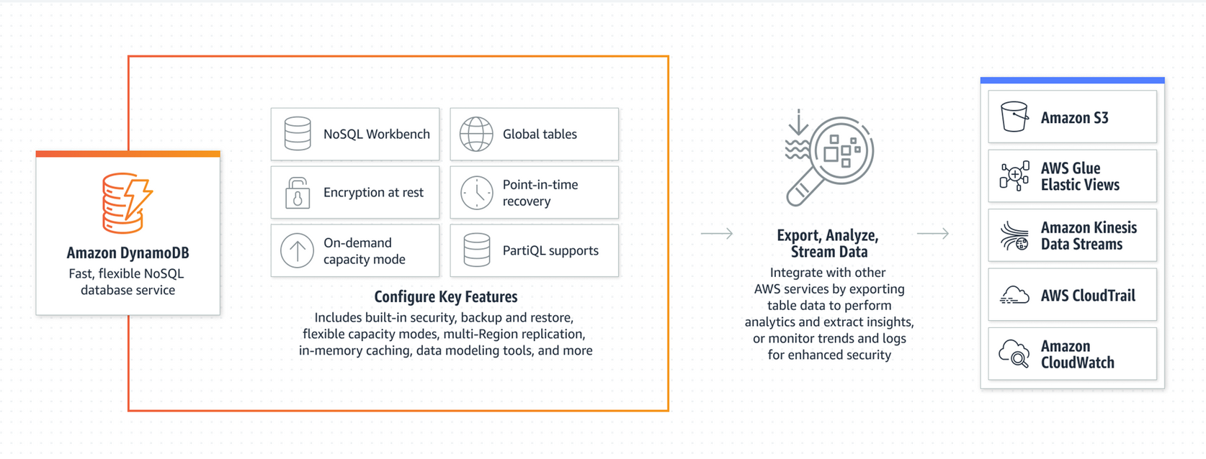
Virtual Private Cloud

Slide 29
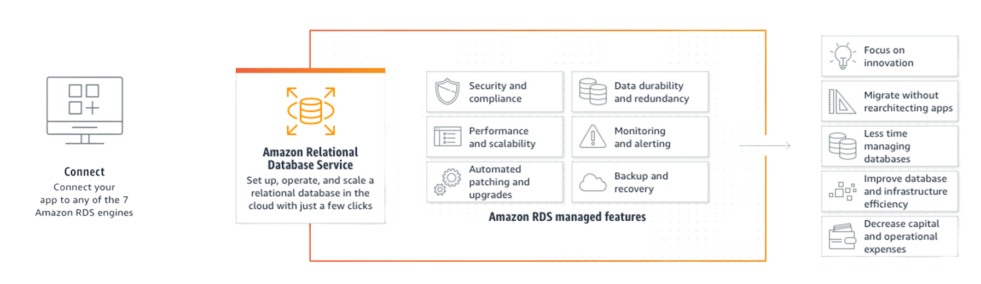
RDS

Slide 30
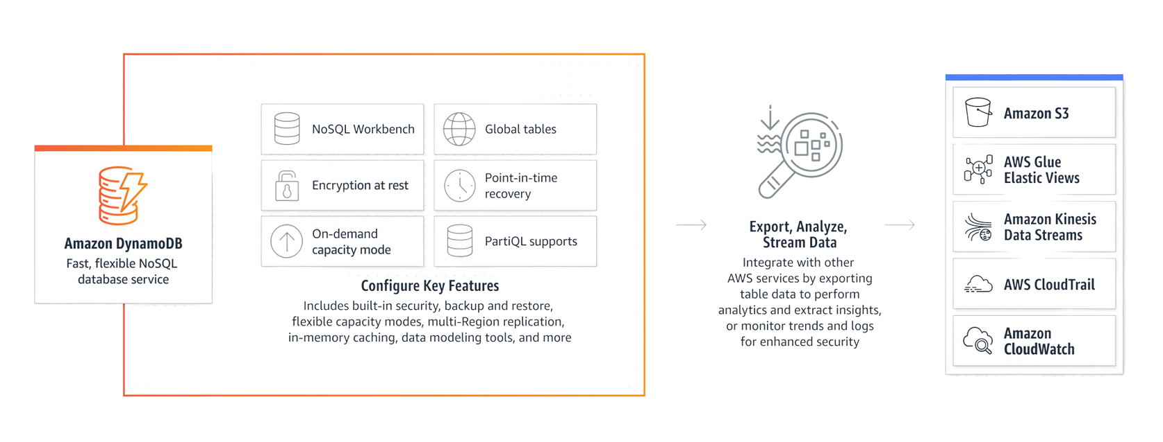
DynamoDb

Slide 31
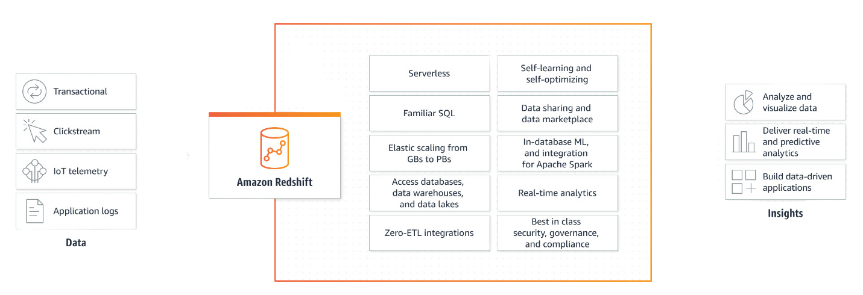
Redshift

Slide 32
BASICS OF
AWS
MODULE: 6
Additional Services
www.aisciences.io

Slide 33



AWS Security
Key Management Service
Secret Manager
IAM

Slide 34
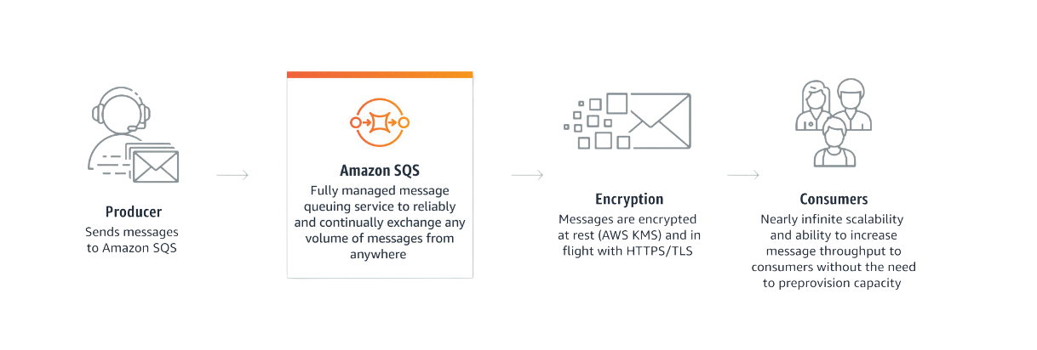
Simple Queue Service

Slide 35
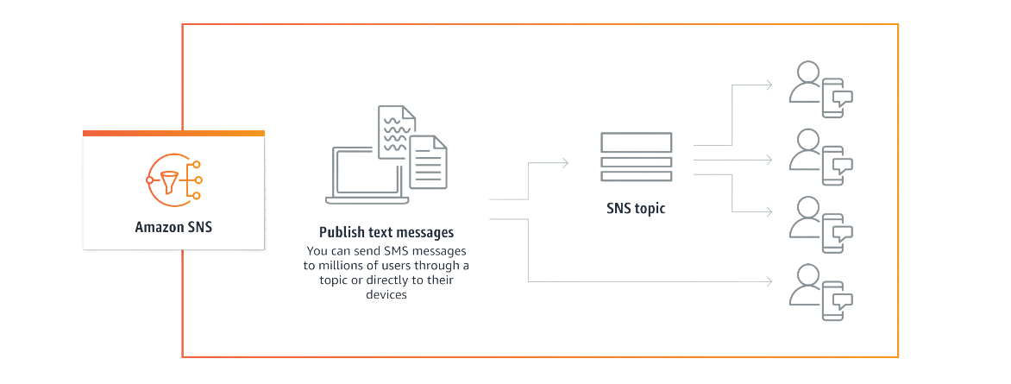
Simple Notification Service

Slide 36
BASICS OF
AWS
MODULE: 7
HandsOn Exercise
www.aisciences.io

Slide 37
Problem Statement
A new Data File is ingested for daily sales records into S3. On Day 1, all orders are inserted so status column shows 'i', on next day few records are inserted, some are updated 'u', some are deleted 'd'. You have to create at least 5 data files and load these input files to S3 one by one. Glue should be used as meta store and use Athena for querying the data on S3. Output Data on S3 should be partitioned on year/month. You should be able to answer below questions using Athena queries.
Find Orders Created on a specific date ?
Find all orders done by a specific user ?
Find orders which are deleted/returned?
Find all active orders by date ?
Find top 3 users who are frequently returning items

Slide 38
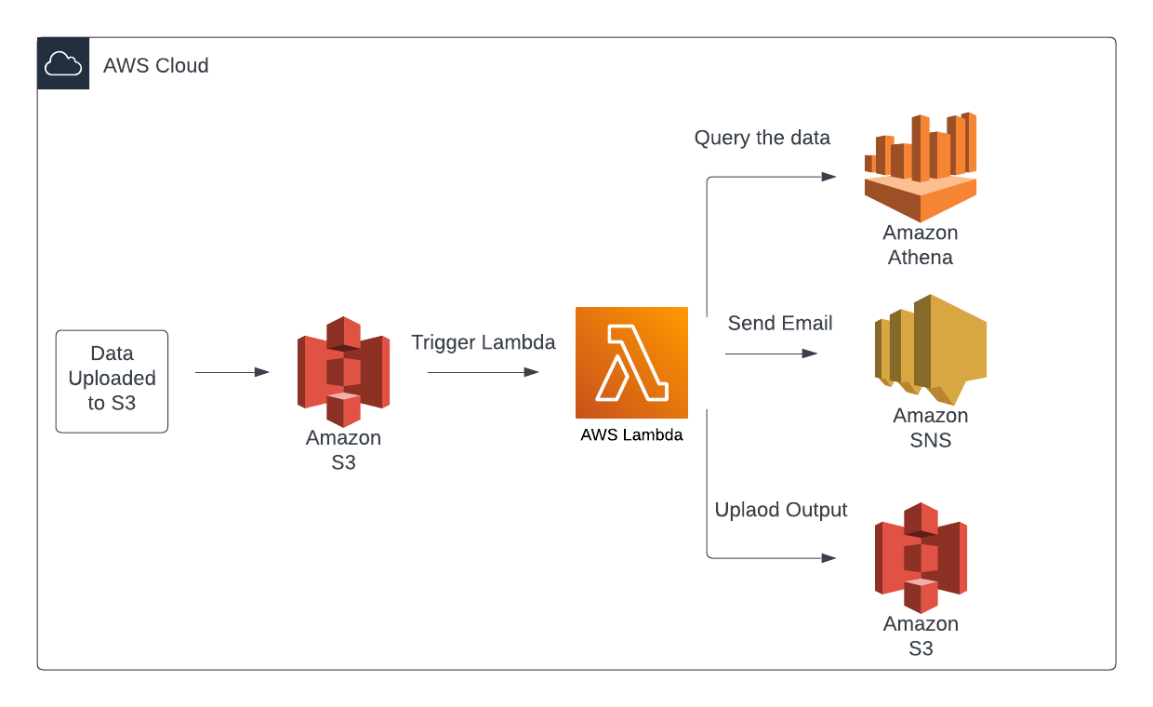
Analysis of Warehouse Data

